Slide 1
Vision-Language Pre-Training with Triple Contrastive Learning
Presented by
Jayasri jetti (R11903013)
Maheswari Thokala (R11836421)
Sushmitha Gorrepati (R11903646)
Sulakshana Mucheli (R11842834)
Sujeeth Reddy Chevula(R11847040)

Slide 2
OUTLINE
Introduction
Related work
Modules
Pre-trained objectives
Improvements
Data sets
Implementation Details
Results
Result Comparison
Future Scope
Conclusion
References

Slide 3
INTRODUCTION
Vision language pre-training by using both cross-modal and intra-modal self-supervision we can come up with triple contrastive learning (TCL).
TCL adds an intra-modal contrastive goal to provide significant advantages in representation learning.
We can enhance the performance by pre-training TCL with large dataset which implies the potential for further improvement with even larger dataset.

Slide 4
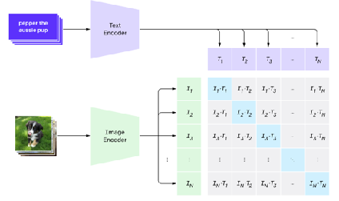
Pre-Training using self supervised manner ->fine tune on downstream tasks
-Vision: exemplars, predicting relative positions, solve jigsaw
-Language: BERT – Masked Language Modeling (MLM)
Vision-Language Pre-Training
-Fusion Encoder(e.g.Oscar,UNITER)
Problem: Each feature lie in different embedding spaces.
Align before fuse(using contrastive loss, maximize global MI)
-Problem 1: Only co-occurring features are captured.
-Problem 2: Fails to consider localized and structural information.

Slide 5
RELATED WORK
Vision-Language Pre-training (VLP) Inspired by the success of self-supervised learning in intra-modal tasks, there is a surging interest in developing pre-training objectives for tasks with multiple modalities (e.g., vision and language).
Although these aforementioned methods achieve remarkable performance, they fail to conduct image-text alignment before fusion, which makes it challenging to learn the interaction between different modalities.
While our approach and ALBEF have similar goals, there are several distinct variances as follows to ensure that the learnt representations are semantically meaningful.
we introduce local alignment to the cross-modal scenario by maximizing mutual information (MI) between local regions and global representations.

Slide 6
TRIPLE CONTRASTIVE LEARNING
1. Cross-Modal Alignment (CMA): matching image-text pairings merged, unmatched pairs separated.
increases the mutual information (MI) between text and image to the maximum.
2. Intra Modal Contrastive (IMC):
Learns how to distinguish between positive and negative samples that are in the same modality.
Positive pairings consist of two randomly selected perspectives of the same image.
Encourage people to acquire representations that preserve semantically related positive pairs' alignment.
3. Local MI maximization (LMI) :
Based on the combined probability of the values of adjacent pixels.
LMI maximization captures specific information.

Slide 7
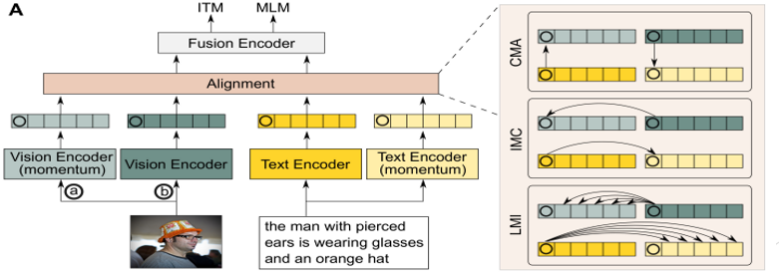
Model
Vision encoder: For learning visual features from the image input, a text encoder.
-These encoders adopts Transformer-Based architecture(TBA).
-Each encoder- paired with momentum encoder that is implemented by momentum-based moving average strategy.

Slide 8
PRE-TRAINED OBJECTIVES
Image Text Matching (ITM):
Ascertain if a pair of images and texts matches or not.
As the combined representation of the input image-text pair, use the fusion encoder's [CLS] token.
Unused samples obtained from batch samplings.
Masked Language Modelling(MLM):
you can forecast the ground truth labels of text tokens that are hidden.
predicated on the visual representations and accompanying text tokens.

Slide 9

IMPROVEMENTS
1. ACCURACY
2. X – VLM
(Multi-grained vision language pre-training)

Slide 10
IMPROVEMENTS
Accuracy:
Indicates that the text and visual elements are separately sent to two distinct transformer blocks rather than being combined.
The specifications of these two transformer blocks are not the same.
Cross-attention techniques are utilized to facilitate cross-modal interaction in order to get better performance. Additionally, no cross-attention between the textual and visual transformer blocks can be allowed in order to maximize efficiency.

Slide 11
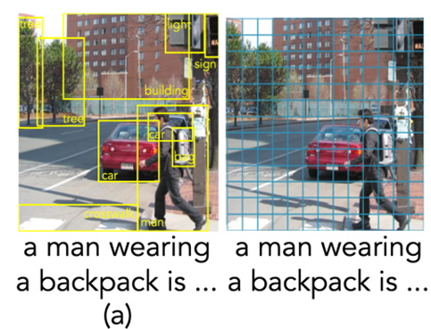
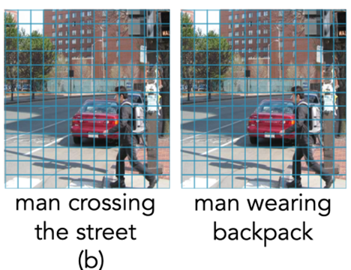
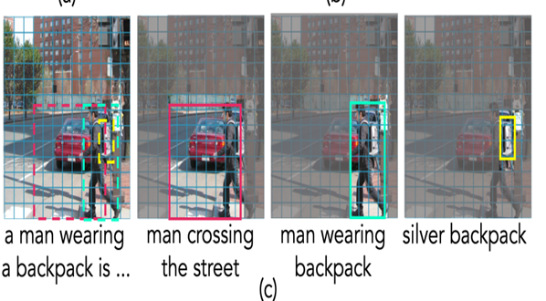
IMPROVEMENTS
X-VLM
(a)The existing methods (b) The methods aligning the (c) Our approach
relying on object detection. Texts with the whole image

Slide 12
IMPROVEMENTS
The majority of vision language pretraining techniques now in use rely on object-centric characteristics that are obtained through object identification and create precise alignments between the texts and the derived features.
These approaches have difficulty learning relationships between several things.
In order to do this, we suggest a brand-new technique for "multi-grained vision language pre-training" known as X-VLM.
Finding visual ideas in an image given the related texts is essential to learning multi-grained alignments. Meanwhile, texts should be aligned with the visual concepts when multi-granular alignments exist.

Slide 13
DATASETS
Pretraining Datasets:
For our experiment, we utilize the data sets listed below.
COCO
The Visual Genome (VG)
Captions Conceptual (CC)
In this work, the pre-training dataset was SBU Captions.

Slide 14
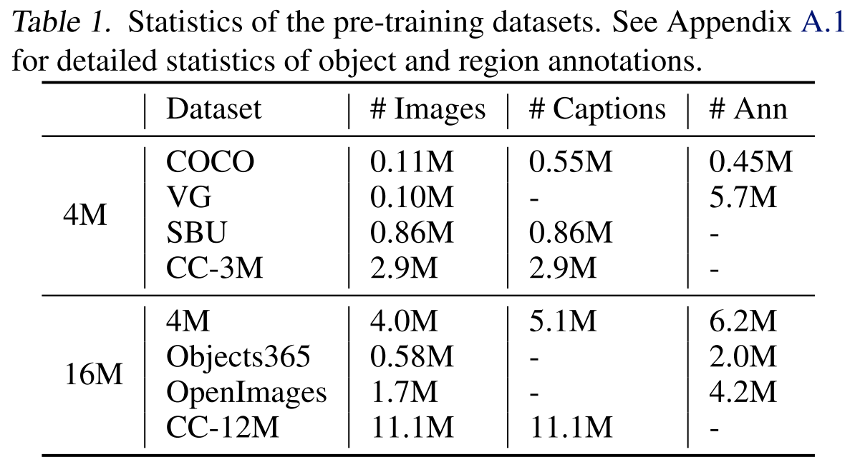
RESULTS

Slide 15
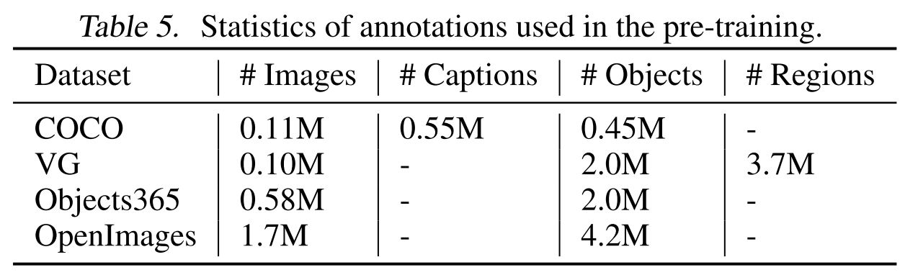

Slide 16
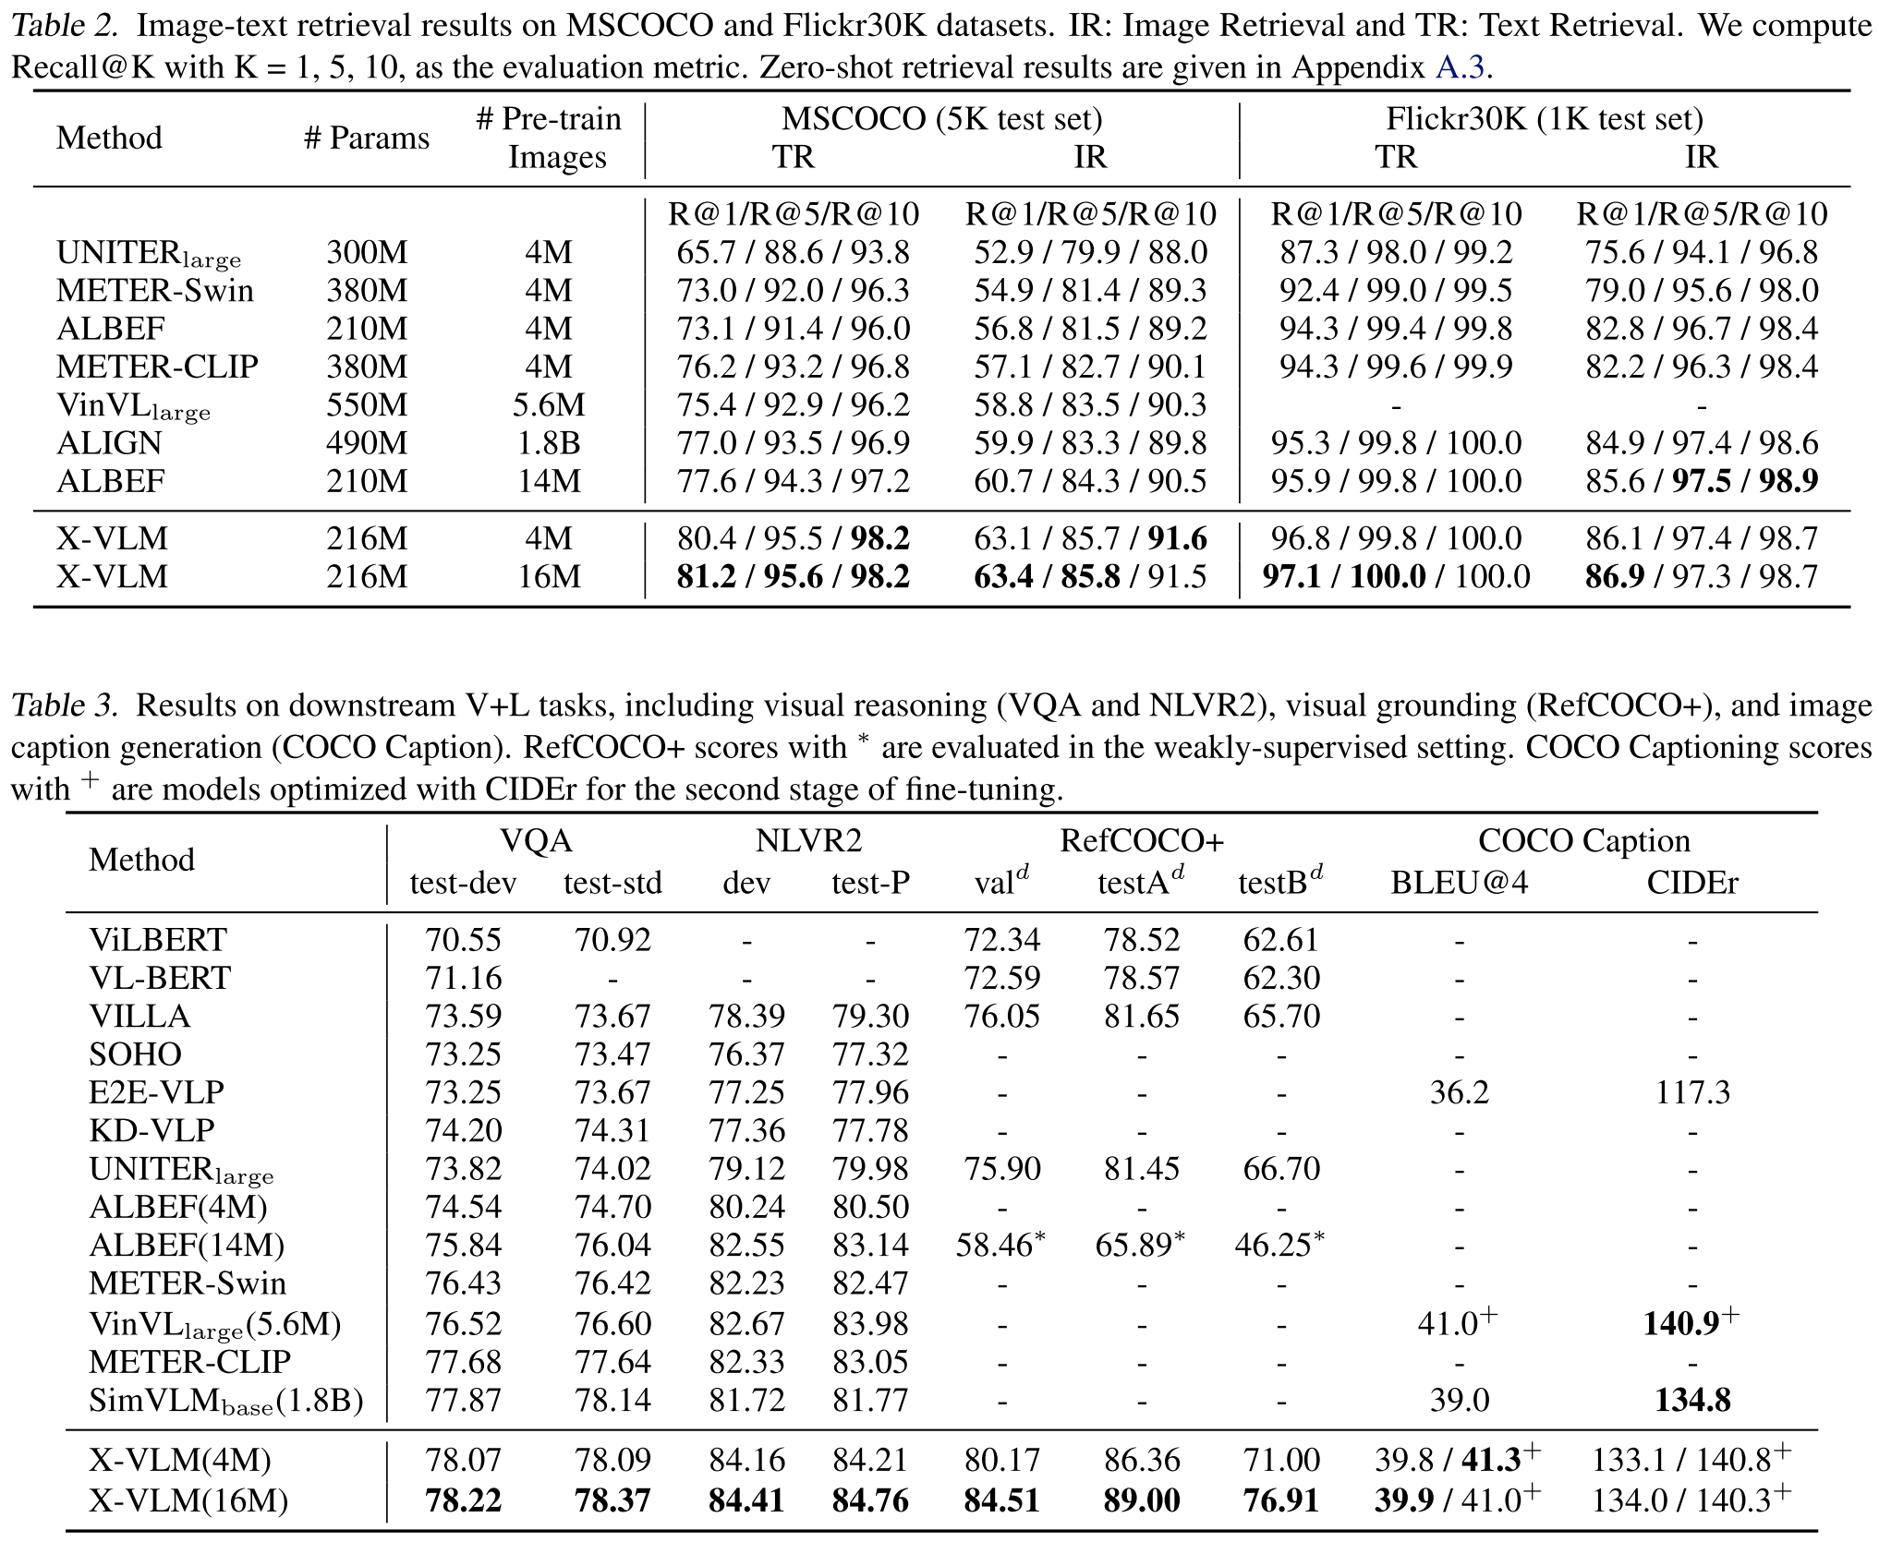
RESULT COMPARISON

Slide 17
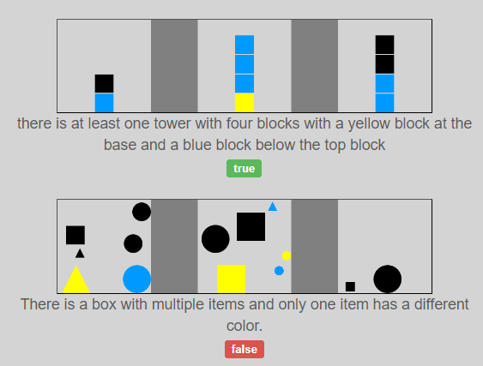
Results(previous model)

Slide 18
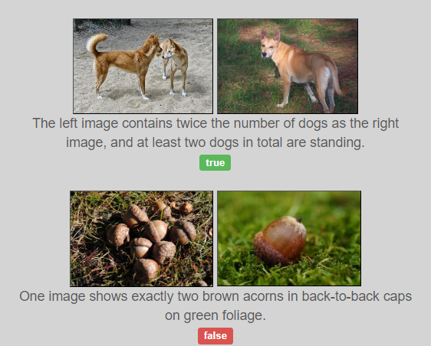
Our model

Slide 19
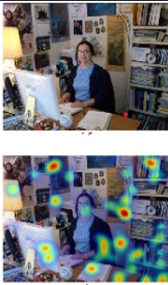
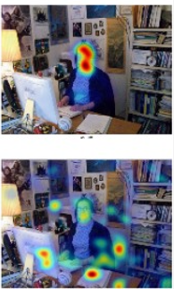
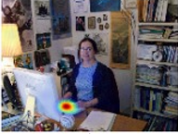

Slide 20
FUTURE SCOPE
In the future, we want to use grid format photos and see improved speed and finer-grained output at reduced image sizes.
In contrast, with Grid-VLP, we won't be able to see both due to the reduced image size.
Furthermore, we would like to continue working on the VLP transformer, which has 10 times the power of the current VLPs.
As a result, the VLP can scale more easily.

Slide 21
CONCLUSION
A powerful and effective method for performing visual language pre-training is what we have called X-VLM.
In order to train the model, visual ideas are identified in the image based on the corresponding texts, and texts are aligned with pertinent visual concepts at many granularities.
We have pre-trained X-VLM using moderately sized 4M and 16M pictures. In addition, there are only 216M parameters in X-VLM.
In terms of comprehending fine-grained vision language alignments, X-VLM has demonstrated superior performance.

Slide 22
REFERENCES
[1] Philip Bachman, R Devon Hjelm, and William Buchwalter. Learning representations by maximizing mutual information across views. arXiv preprint arXiv:1906.00910, 2019. 2, 3, 5
[2] Mohamed Ishmael Belghazi, Aristide Baratin, Sai Rajeswar, Sherjil Ozair, Yoshua Bengio, Aaron Courville, and R Devon Hjelm. Mine: mutual information neural estimation. arXiv preprint arXiv:1801.04062, 2018. 3, 4
[3] Soravit Changpinyo, Piyush Sharma, Nan Ding, and Radu Soricut. Conceptual 12m: Pushing web-scale image-text pretraining to recognize long-tail visual concepts. In Proceedings of the IEEE/CVF Conference on Computer Vision and Pattern Recognition, pages 3558–3568, 2021. 6
[4] Feilong Chen, Duzhen Zhang, Minglun Han, Xiuyi Chen, Jing Shi, Shuang Xu, and Bo Xu. Vlp: A survey on visionlanguage pre-training. arXiv preprint arXiv:2202.09061, 2022. 1

Slide 23
THANK YOU

